Slide 1
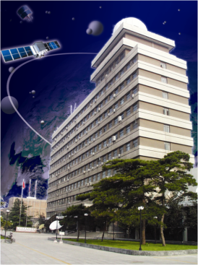
Evolution of Fengyun-3
Direct Broadcasting Software Package
Lei Yang¹, Peng Zhang¹, Zhongdong Yang¹, Songyan Gu¹, Aijun Zhu¹, Xiuqing Hu¹, Di Xian¹, Xiuzhen han¹, Maonong Ran², Ping Qin² and Xuexing Guo²
1: National Satellite Meteorological Center ,CMA
2: HuaYun ShineTek.
yangl@cma.gov.cn
June 2019, IMAPP/CSPP 2019 , Chengdu, China

Slide 2
Outline
Brief history and future for Fengyun-3
Typical Receive equipment and software
FY-3 HRPT/MPT status
DB User distribution
Typical Applications

Slide 3
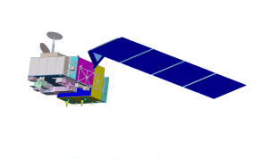
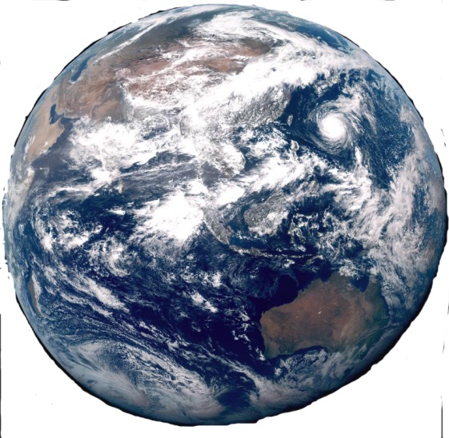
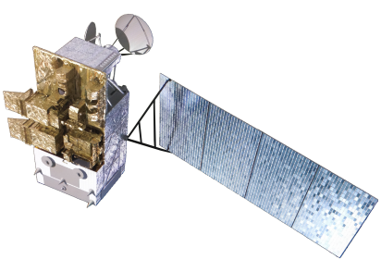
1. Brief of FengYun Polar satellites
FengYun Polar-orbiting meteorological satellites
FY-3A(AM)
FY-3C(AM)
FY-3A/C：AM Orbit
FY-3B/D: PM Orbit
FY-3D(PM)
FY-3B(PM)
Satellite | Launch | Nature | Design life | Status
FY-3A | May 27, 2008 | Experimental | 3 years | Retired
FY-3B | Nov. 5, 2010 | Experimental | 3 years | Operational
FY-3C | Sep. 23, 2013 | Operational | 5 years | Operational
FY-3D | Nov. 15, 2017 | Operational | 5 years | Operational

Slide 4
Future Plan for Fengyun Polar-orbiting series
Polar-orbiting series | Satellite | Orbit | Launch | Design life
The 3rd batch of FY-3 | FY-3E | Early morning | 2020(plan) | 8 years
 | FY-3F | AM | 2021(plan) | 8 years
 | FY-3G | Inclined orbit | 2022(plan) | 6 years
 | FY-3H | PM | 2023(plan) | 8 years
The 4th batch of FY-3 | FY-3I | Early morning/AM | 2025(plan) | 8 years
 | FY-3J | Inclined orbit | 2027(plan) | 7 years
Satellite | 2019 | 2020 | 2021 | 2022 | 2023 | 2024 | 2025 | 2026 | 2027 | 2028 | 2029 | 2030 | 2031 | 2032 | 2033 | 2034 | 2035
FY-3E
FY-3F
FY-3G
FY-3H
FY-3I
FY-3J
EM
AM
RM
PM

Slide 5
Future Fengyun Satellite Fleet
In the next 10 years, CMA will have 6 LEO operational satellites.
Orbit 1(for EM,AM,PM)
type：sun synchronous orbit
Orbit altitude：836km
Orbit inclination：98.7°
FY-3F(AM)
FY-3E(EM)
FY-3R(Inclined)
Orbit 2(for RM)
type：Low inclination orbit
Orbit altitude：407km
Orbit inclination：50°
FY-3 (09/10)
FY-3G(PM)
The LEO realizes the network of covering the EM, AM and PM satellite observation, and the time limit of global data updating has been raised from 6 hours to 3 hours. Fine detection of elements such as precipitation and greenhouse gas.

Slide 6
Payloads & Measurement Capability of LEO Programme
Item | Sensor Suite | Satellite Sensor | FY-3A (AM) | FY-3B (PM) | FY-3C (AM) | FY-3D (PM) | FY-3E EM | FY-3F AM | FY-3G PM | FY-3R Rainfall
1 | Optical Imagers | MERSI | √ | √ |  |  | √（LL） | √（III） | √（III） | √（III-Simplified）
2 | Passive Microwave Sensors | MWTS | √ | √ |  |  | √ | √ | √
 |  | MWHS | √ | √ |  |  | √ | √ | √
 |  | MWRI | √ | √ |  |  |  | √ | √ | √
3 | Occultation Sounder | GNOS |  |  |  |  | √ | √ | √ | √
4 | Active Microwave Sensors | WindRAD |  |  |  |  | √ | √
 |  | Rainfall RAD |  |  |  |  |  |  |  | √
5 | Hyperspectral Sounding Sensors | HIRAS |  |  |  |  | √ | √ | √
 |  | GAS (Greenhouse Gases Absorption Spectrometer) |  |  |  |  |  |  | √
 |  | OMS (Ozone Mapping Spectrometer) |  |  |  |  |  | √
6 | Radiance Observation Sensor Suite | ERM | √ | √ |  |  |  | √
 |  | SIM | √ | √ |  |  | √ | √
 |  | SSIM (Solar Spectral Irradiation Monitor) |  |  |  |  | √
7 | Space Weather Sensor Suite | SEM | √ | √ |  |  | √
 |  | Wide Angle Aurora Imager |  |  |  |  |  |  | √
 |  | Ionosphere photometer |  |  |  |  | √(Multi-angle) |  | √
 |  | Solar X-EUV Imager |  |  |  |  | √

Slide 7
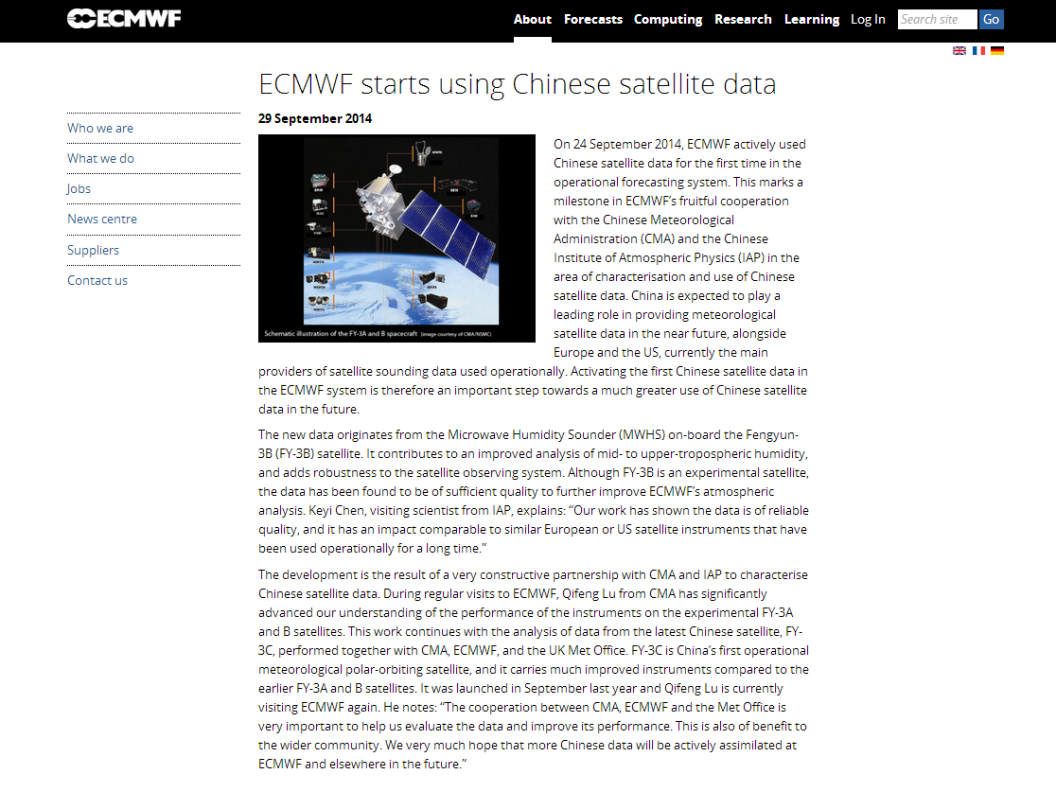
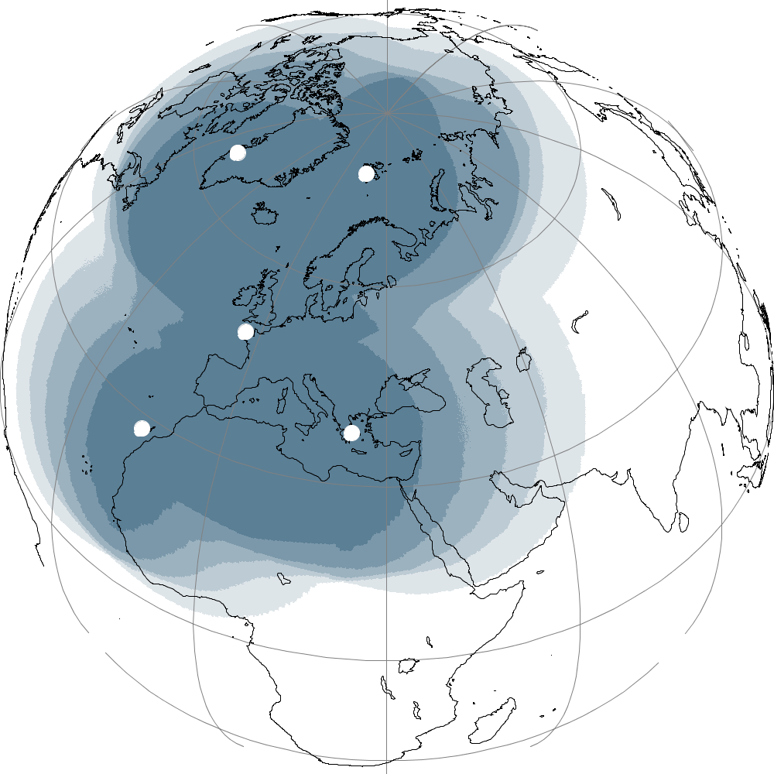
International User Community
Global Data
Regional Data
Kangerlussuaq
Svalbard
Lannion
Maspalomas
Athens
FY-3C sounding data have been assimilated into CMA GRAPES, ECMWF, UK NWP model operationally.
EUMETSAT Advanced Retransmission Service

Slide 8
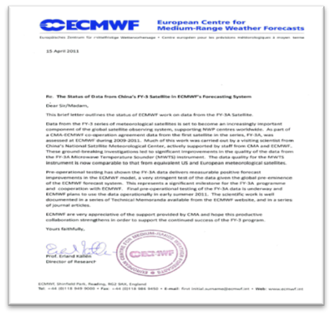
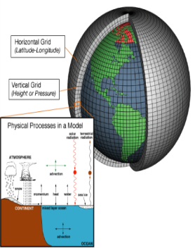
Cost Function
The data quality is now comparable to that from equivalent US and European meteorological satellites

Slide 9
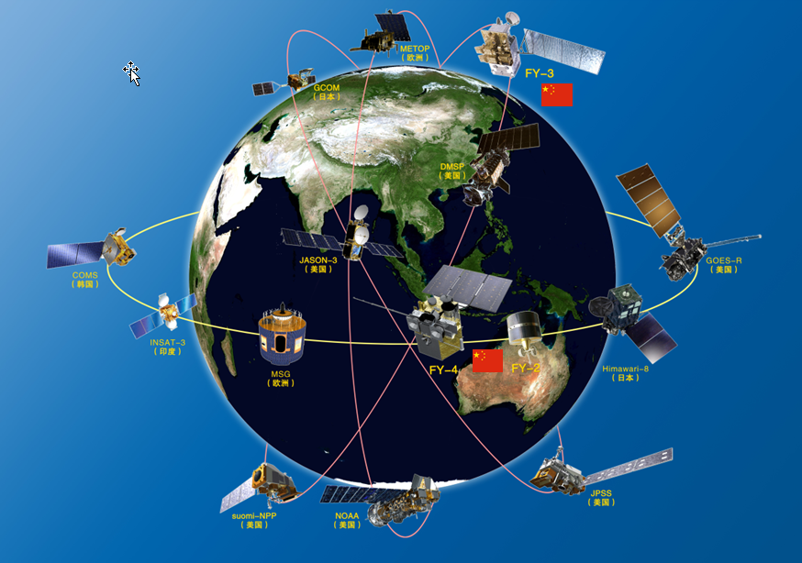
Important Component of WMO Space Program
reliable and sustained observation in operation
open data policy to free access

Slide 10
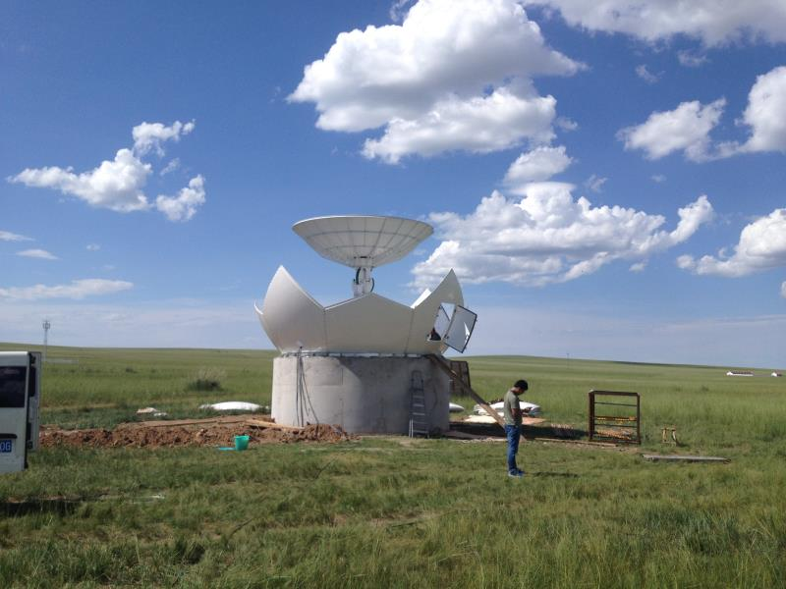
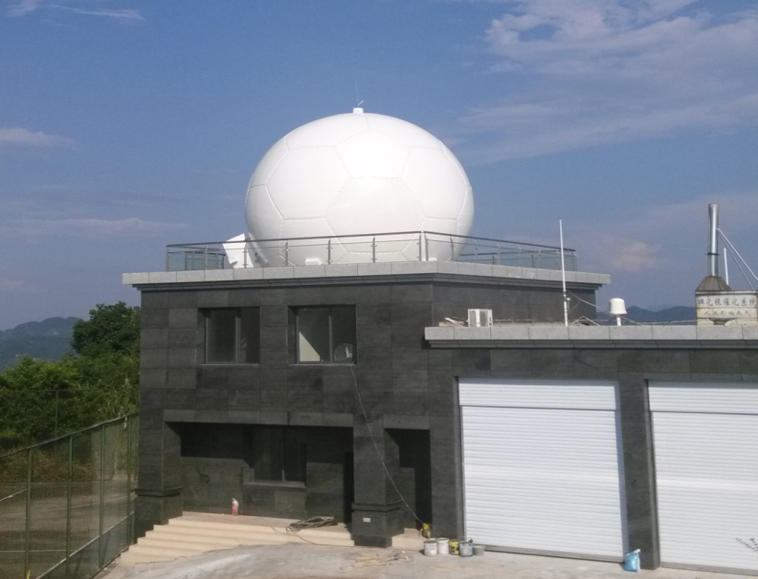
Typical Receiving Equipment
Antenna key parameters:
Diameter | 4.2m
Frequency | L band 1698 ~1710 MHz X band7750 ~ 7850 MHz 8025~8400MHz
Gain | L band- GLR33.3＋20log(f/1.698)dBi X band- GXR46.9＋20log(f/7.75)dBi
Modulation | BPSK/QPSK

Slide 11
DB Software Features
For DB data preprocessing
FY-3 preprocessing software package is a software system for preprocessing direct broadcast (DB) data from FY-3 series satellites.
It supports processing DB data of VIRR, MERSI, MWHS, MWTS, IRAS/HIRAS and MWRI from FY-3A, FY-3B , FY-3C, FY-3D.
It consists of two software packages, FY-3 MPT/HRPT Level-0 data generation software package and FY-3 MPT/HRPT Level-1 data preprocessing software package.
Testing data will provided via the software package in the future.
Both the software and satellite to ground interface document can be abtained via http://satellite.nsmc.org.cn.
For FY-3D,
Software development group has been set up since May 2017,
FY-3D launch date, Nov 2017. Operational software allocated in NSMC started to work. The first version for DB software has been set up since then.
In April 2018, the DB software has been modified and updated according to the on-orbit test results.
The software has been delivered to inner quality management for software test and the test was finished in July 2018.
The first version for DB SW has been delivered to the public on 27 Aug. 2018.
An updated version has been provided according to the users feedbacks in April 2019.
Notes:
New feature:提供测试数据，提供多线程处理，等等新特性

Slide 12
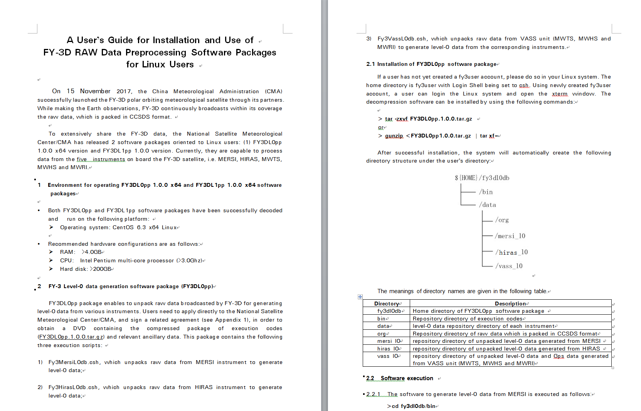
User Guide

Slide 13
Environment for operating DB oftware
Operating system: CentOS_6.3_x64 Linux
Recommended hardware configurations are as follows:
RAM: >4.0GB
CPU: Intel Pentium multi-core processor (>3.0Ghz)
Hard disk: >200GB

Slide 14
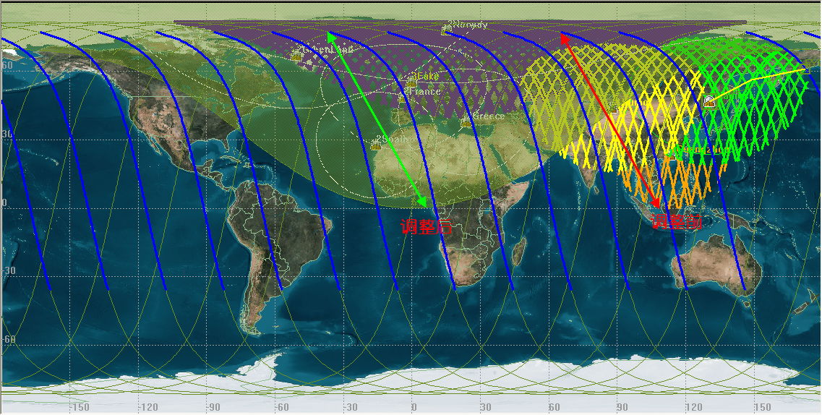
FY-3 HRPT/MPT Status
FY-3B: HRPT + MPT, MPT(MERSI), HRPT(other data except MERSI), suffering from power shortage, FY-3B HRPT/MPT only covers China and Europe.
FY-3C: Only HRPT can work due to the power problem. It only covers China and Europe.
FY-3D: FY-3D and follow-ons use X-band MPT channel.
Extended Spatial Coverage after FY-3C satellite power shortage

Slide 15
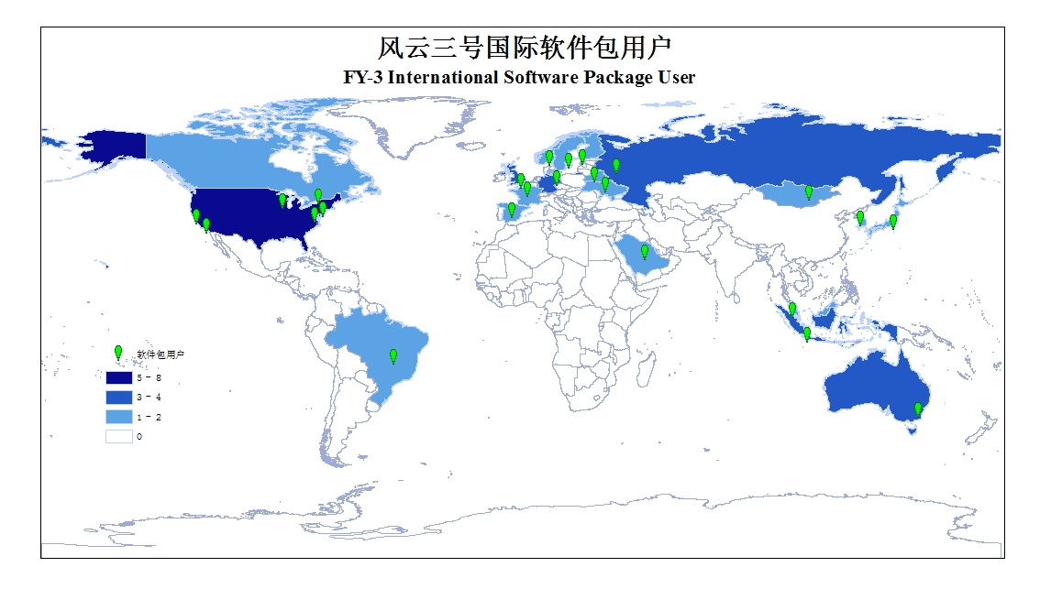
User Distribution
More than 45 International DB Users across 24 countries. At least 116 users who get VASS data by the service EARS-VASS(Eumetsat Advanced Retransmission Service).
Notes:
EARS的用户分布

Slide 16
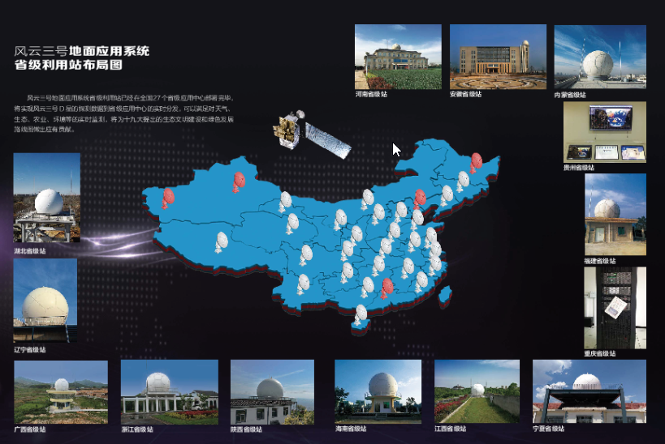
User Distribution
More than 60 DB Users inside China.
Notes:
EARS的用户分布

Slide 17
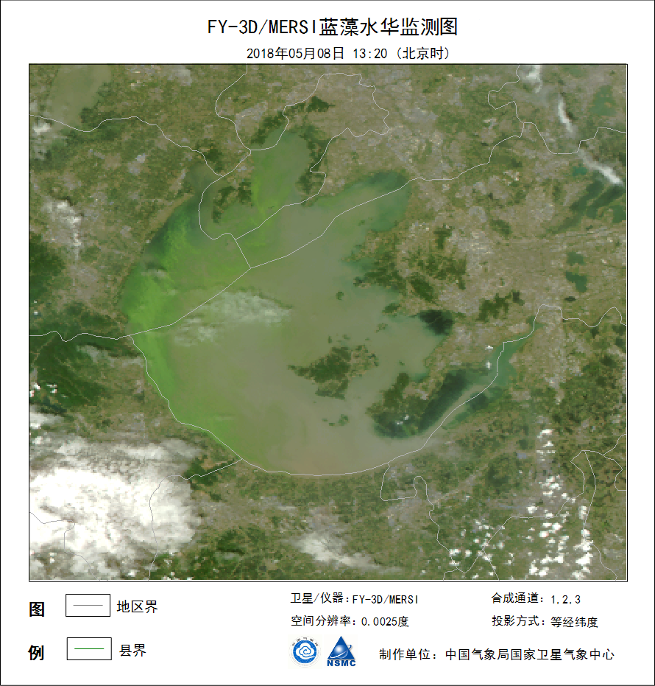
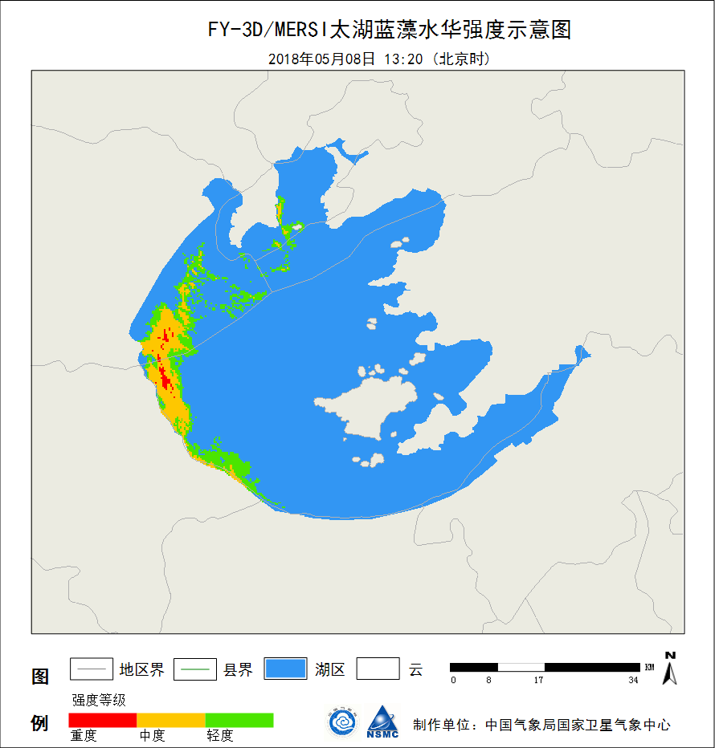
Typical Applications by using DB Data
With those efforts, NSMC try to help advancing the NWP, climate and environmental communities.
Monitoring of cyanobacteria bloom
图1 FY-3D气象卫星太湖蓝藻水华监测图 ( 2018年5月8日)
图2 FY-3D气象卫星太湖蓝藻水华强度示意图 ( 2018年5月8日)
Figure1 Cyanobacteria bloom monitoring（May 8 2018）

Slide 18
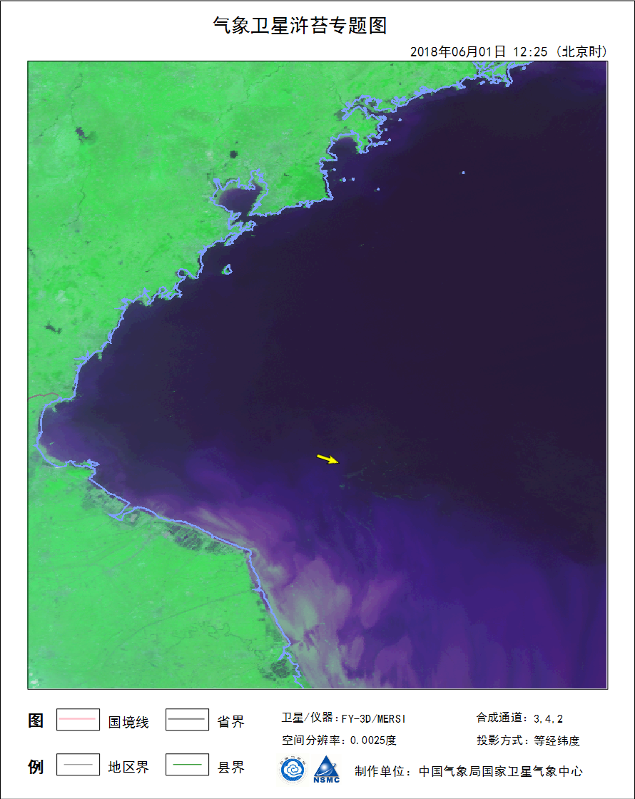
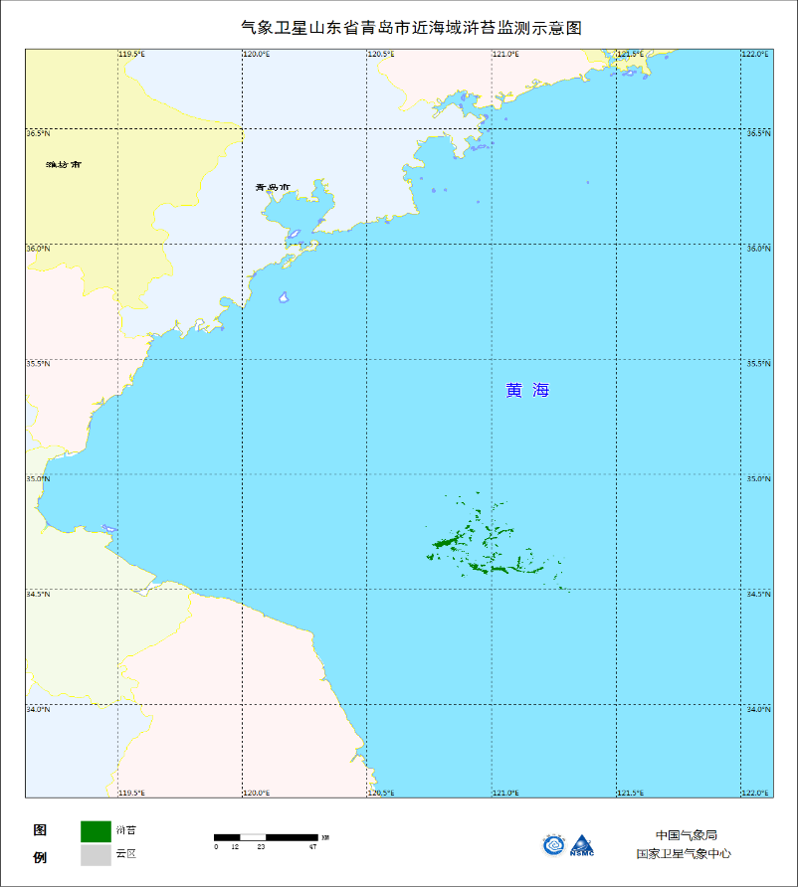
Typical Applications by using DB Data
Algae monitoring
图2 FY-3D气象卫星黄海海域浒苔监测示意图 ( 2018年6月1日)
图1 FY-3D气象卫星黄海海域浒苔专题图 ( 2018年6月1日)
Figure1 Algae monitoring（June 1 2018）

Slide 19
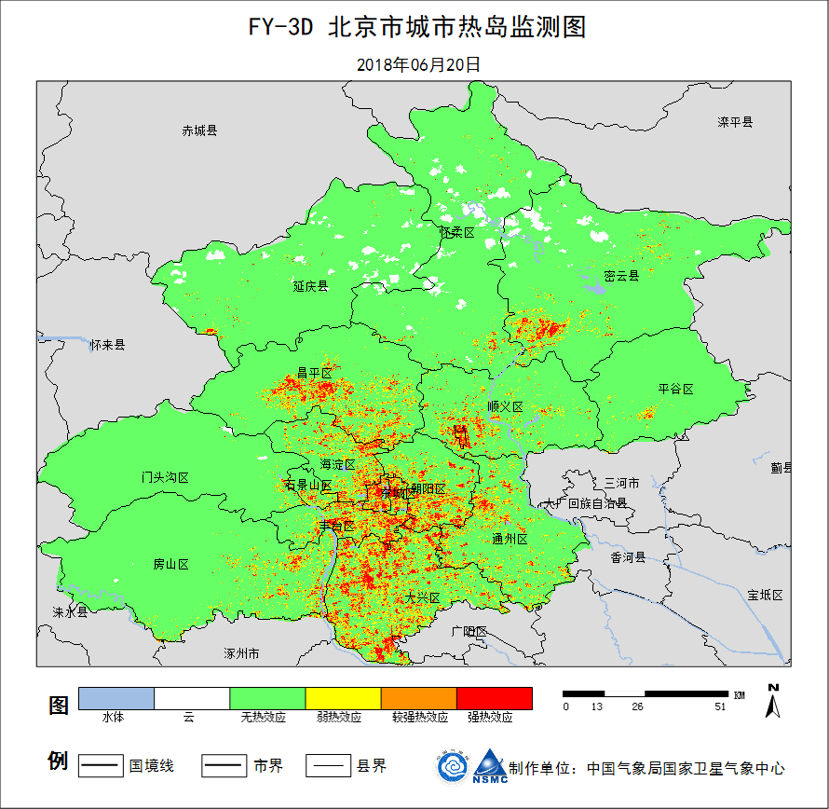
Typical Applications by using DB Data
urban heat island Monitoring
Figure1 Urban heat island monitoring（June 20 2018）

Slide 20
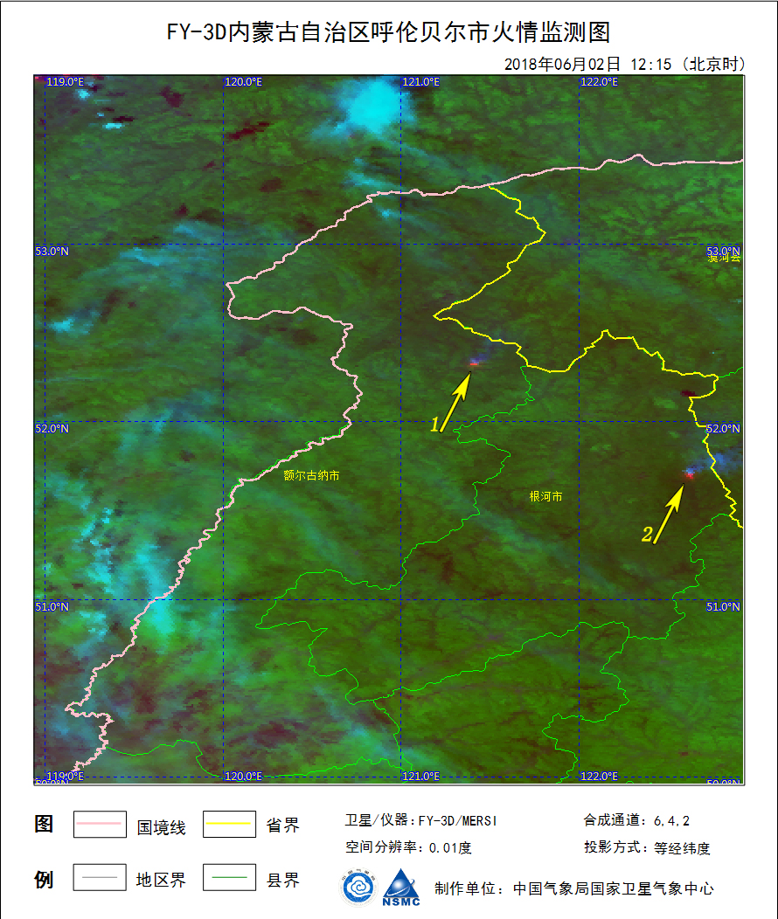
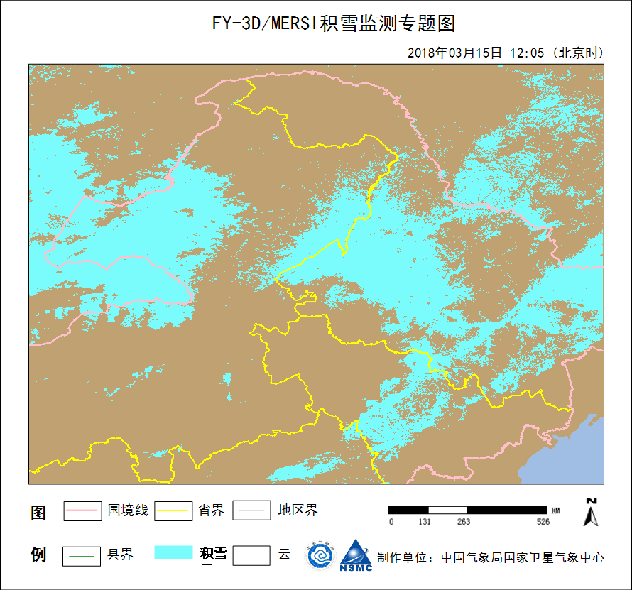
Typical Applications by using DB Data
Fire
Snow
图2 FY-3D气象卫星内蒙古自治区呼伦贝尔市火情监测图
（2018年6月2日12时15分）
图1 FY-3D气象卫星东北区域积雪专题图（2018年3月15日12时）
Figure1 Fire monitoring（June 2 2018）

Slide 21
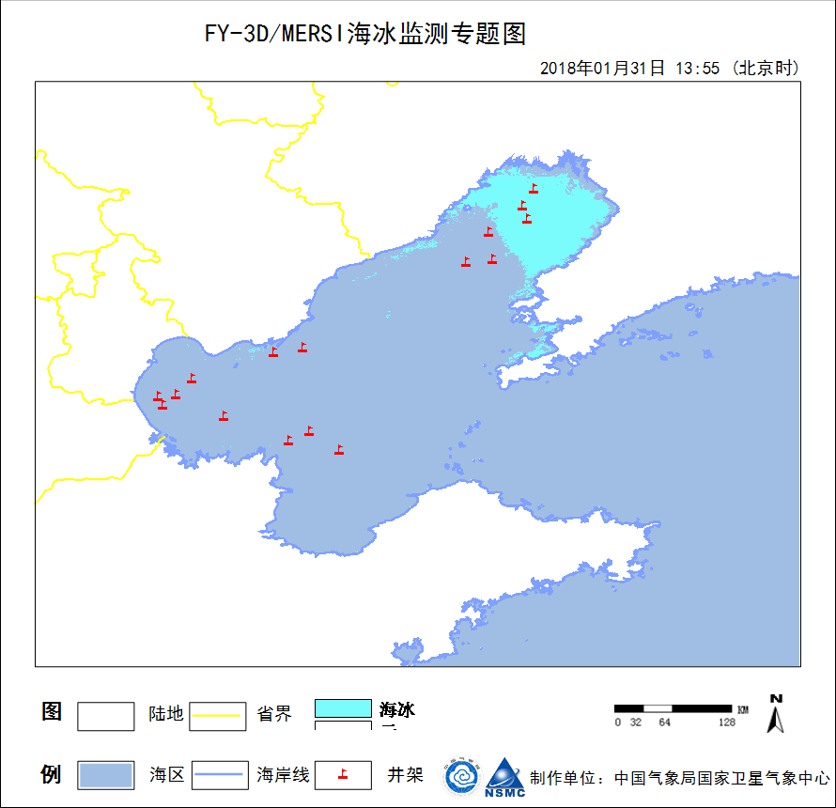
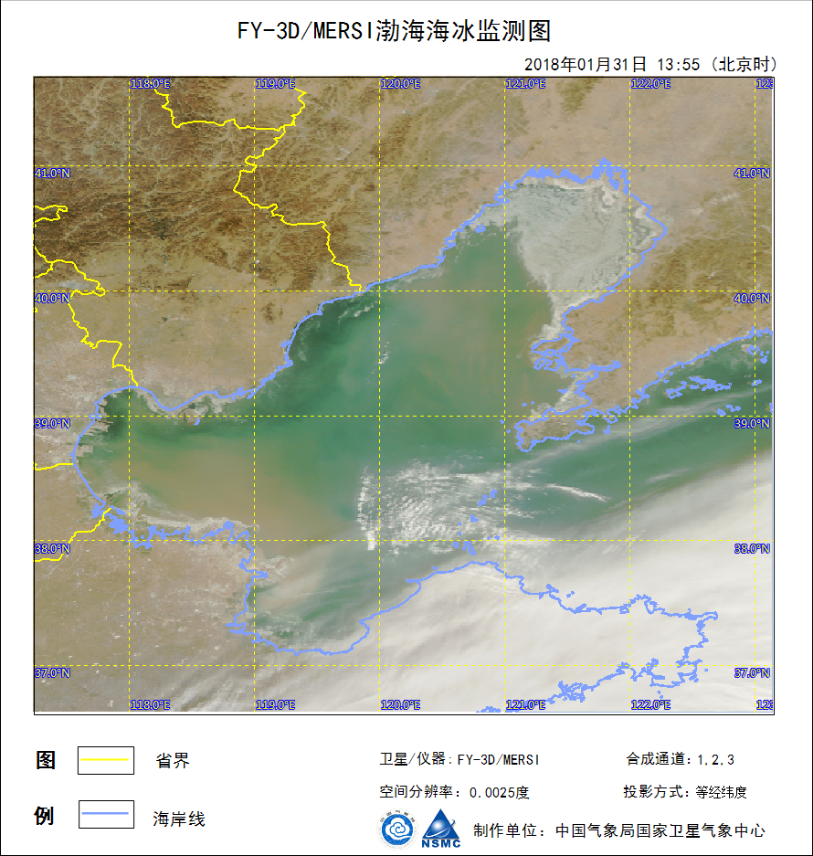
Typical Applications by using DB Data
Sea-ice
图1 FY-3D气象卫星渤海湾海冰监测专题图
（2018年1月31日13时）
图2 FY-3D气象卫星渤海湾海冰监测图
（2018年1月31日13时）
Figure1 Sea ice monitoring（31 Jan 2018）

Slide 22
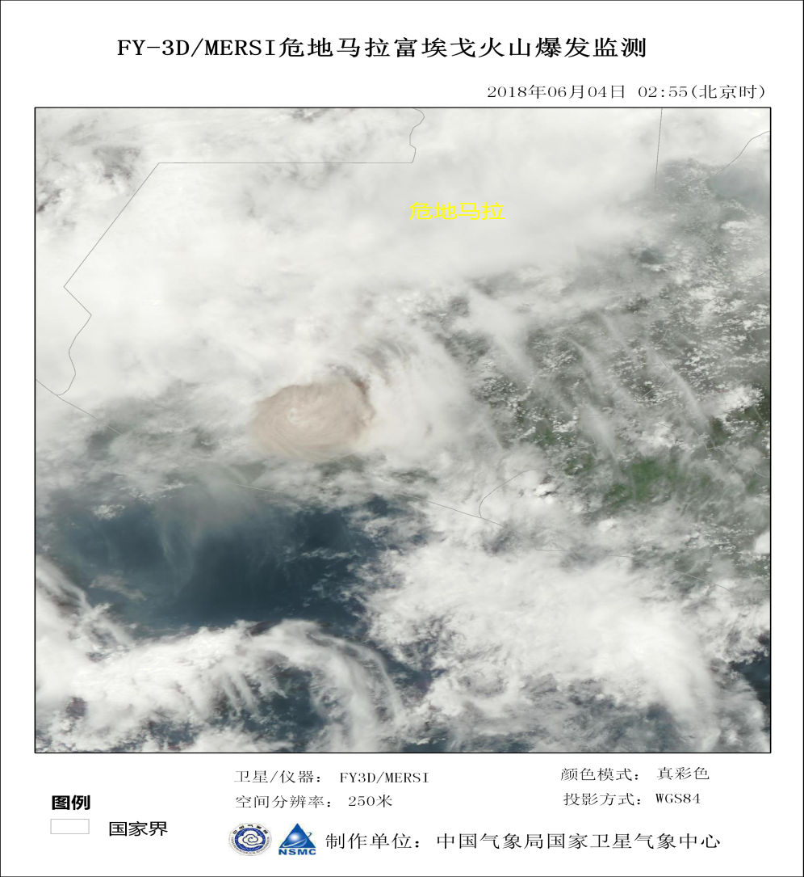
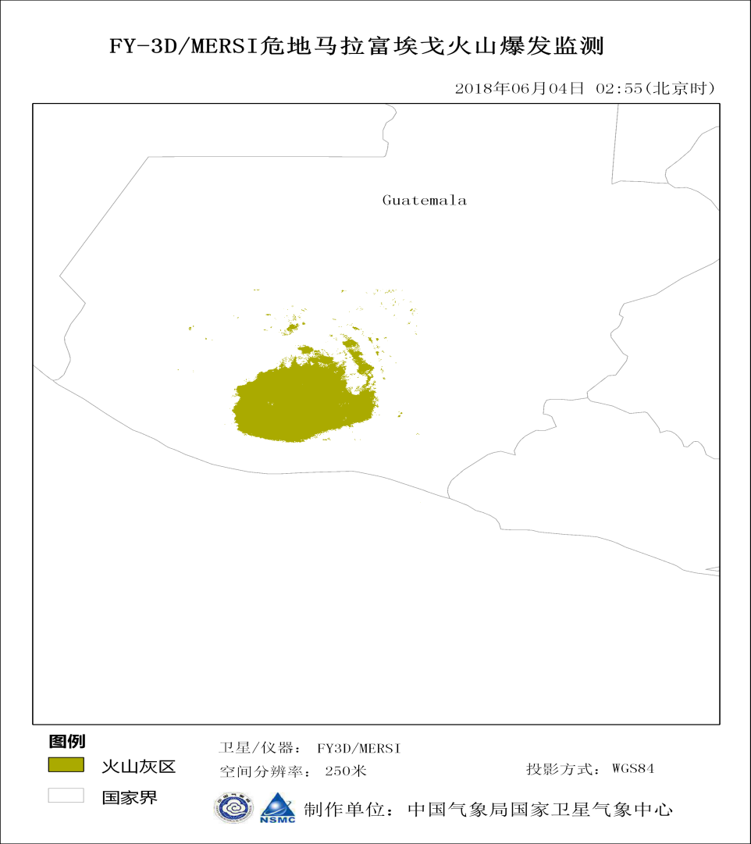
Typical Applications by using DB Data
volcanic ash cloud
Fig.1 Guatemala volcanic ash cloud
（4 June 2018 02:55 Beijing Time）

Slide 23
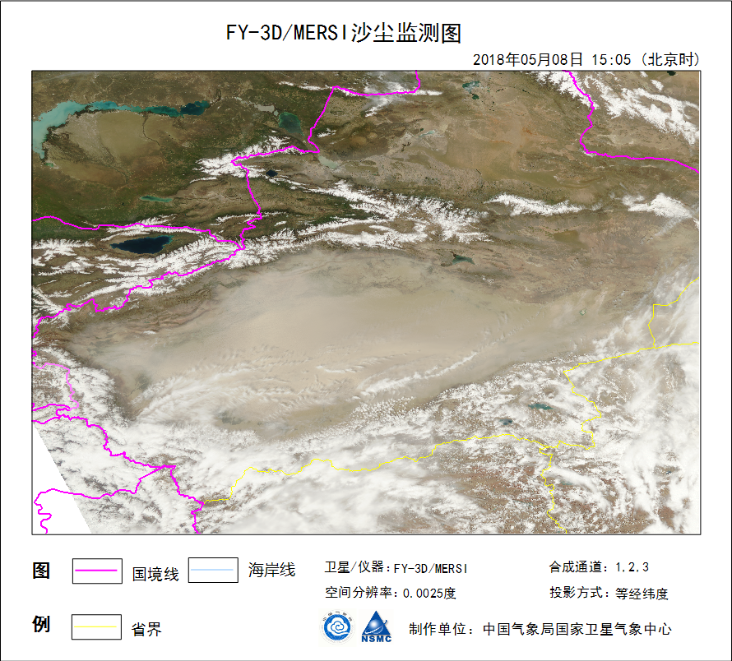
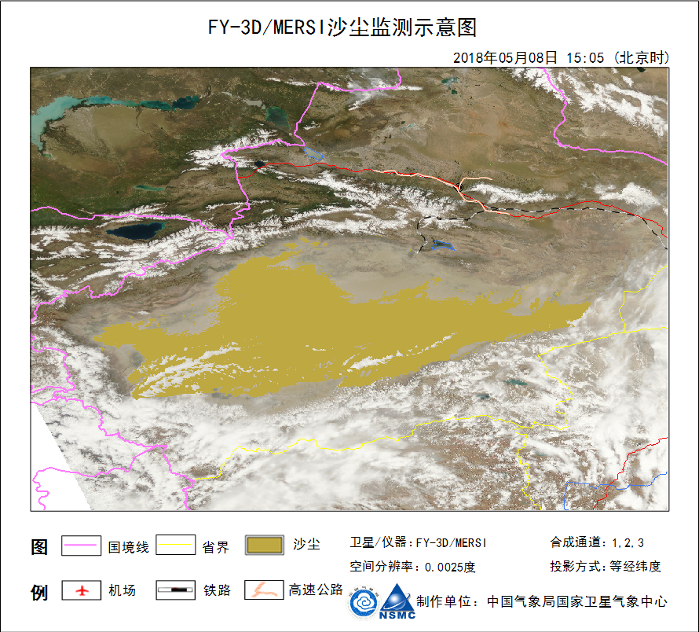
Typical Applications by using DB Data
Sand storm
）
Figure1 Sand storm monitoring（May 8 2018 UTC1500）

Slide 24
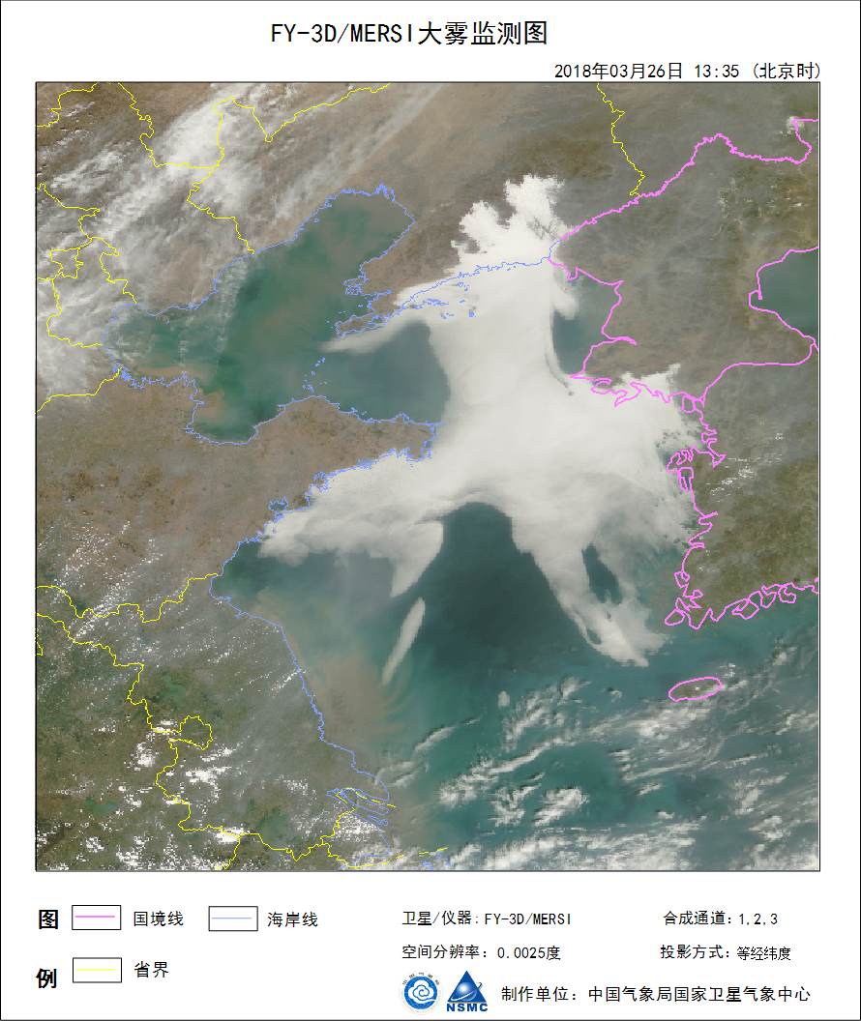
Typical Applications by using DB Data
Fog
Figure1 Fog monitoring（26 March 2018）

Slide 25
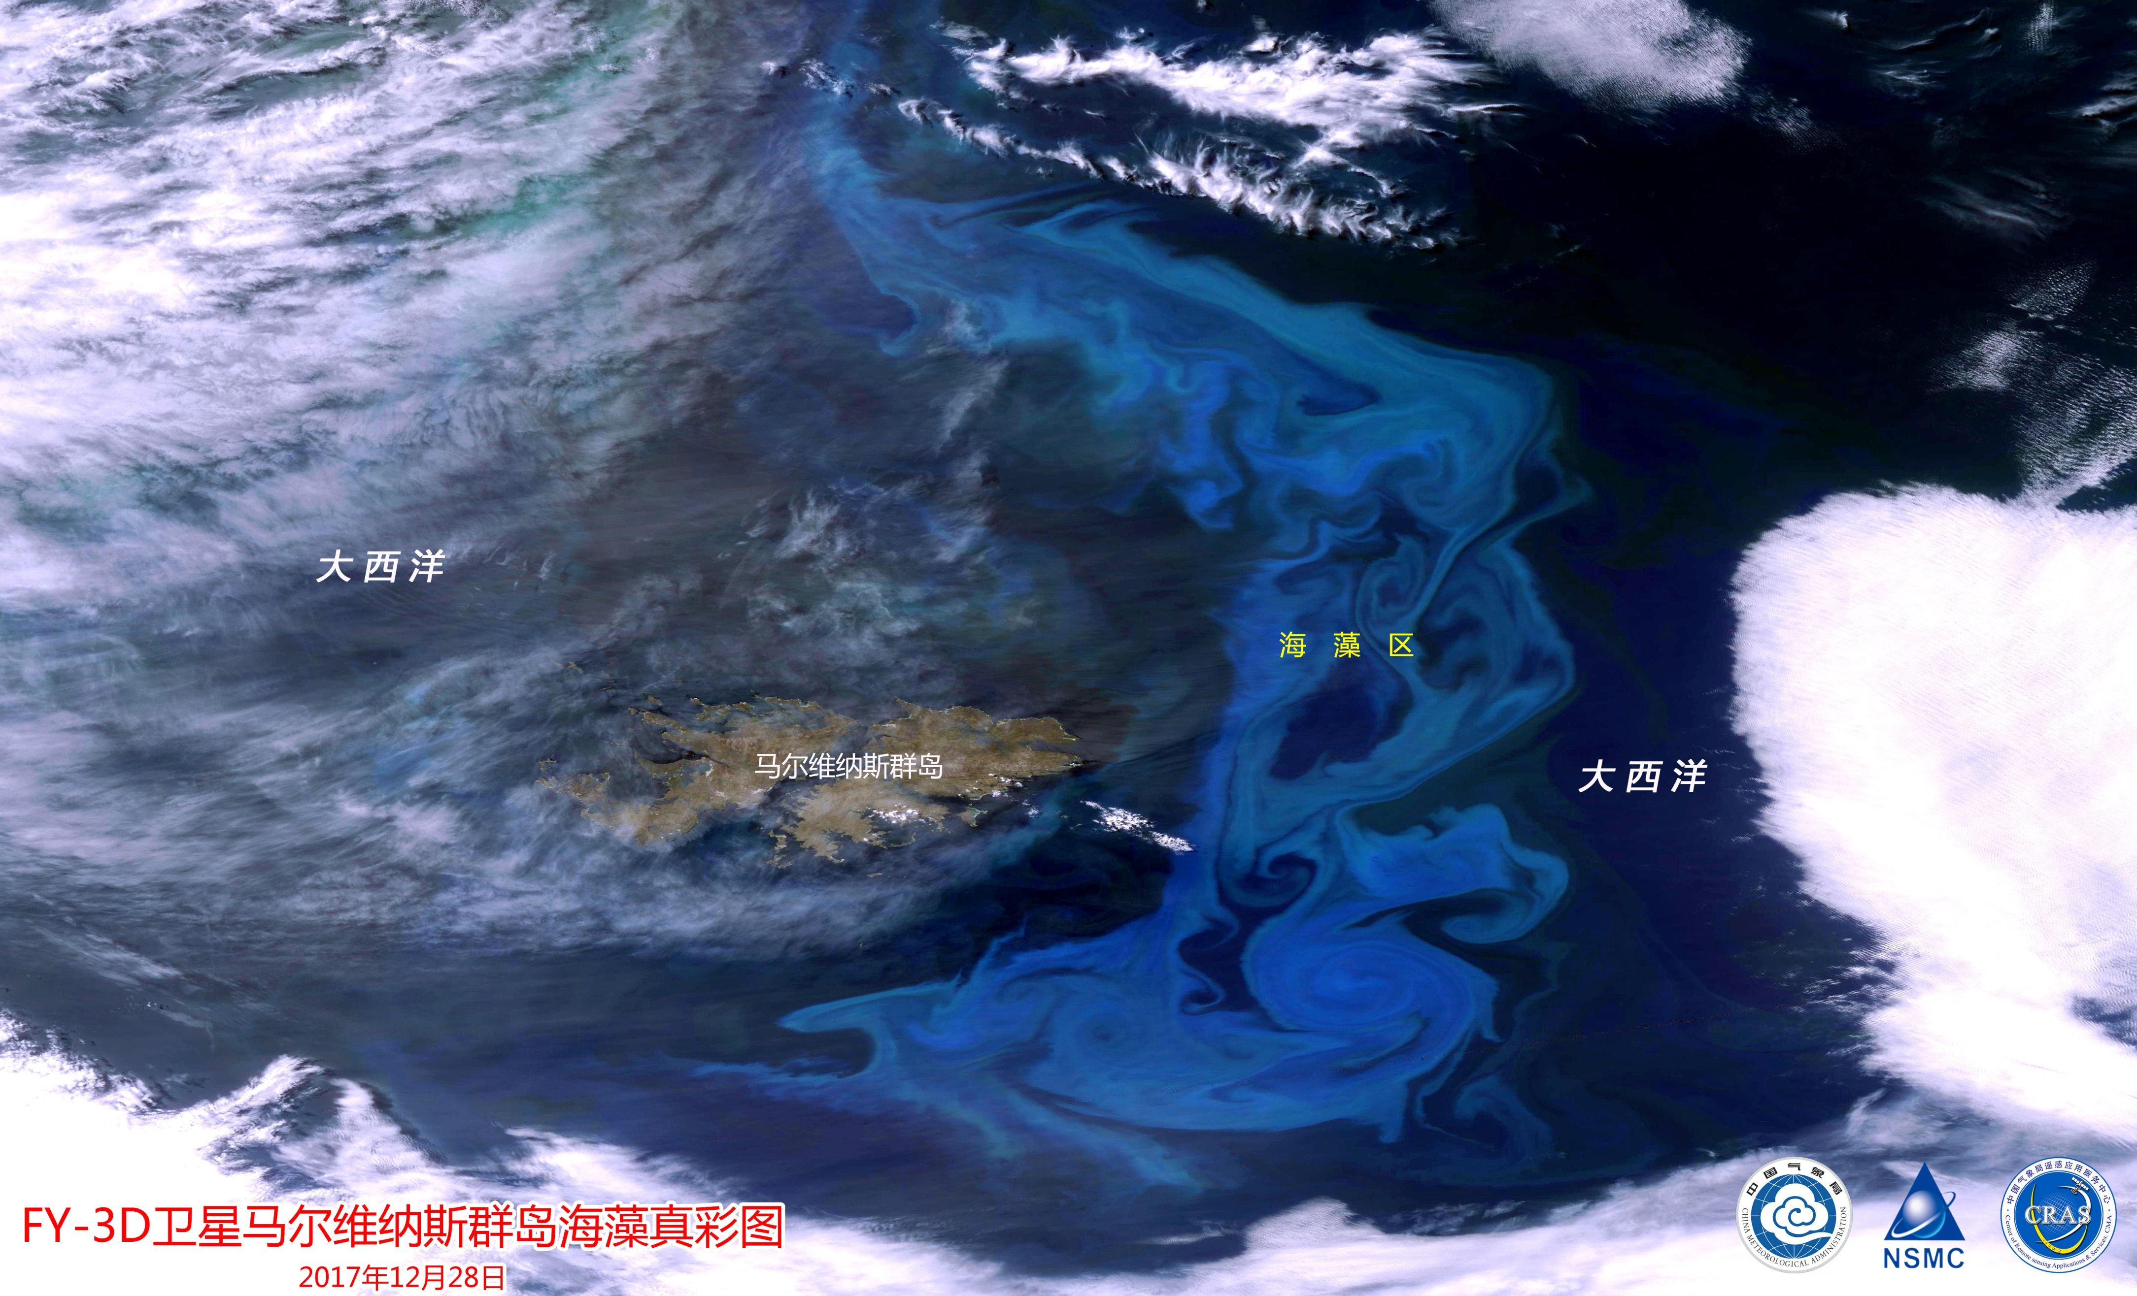
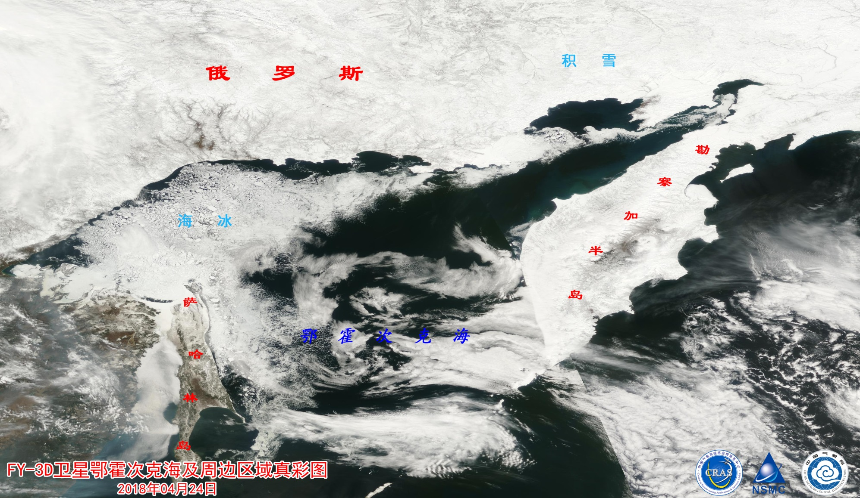
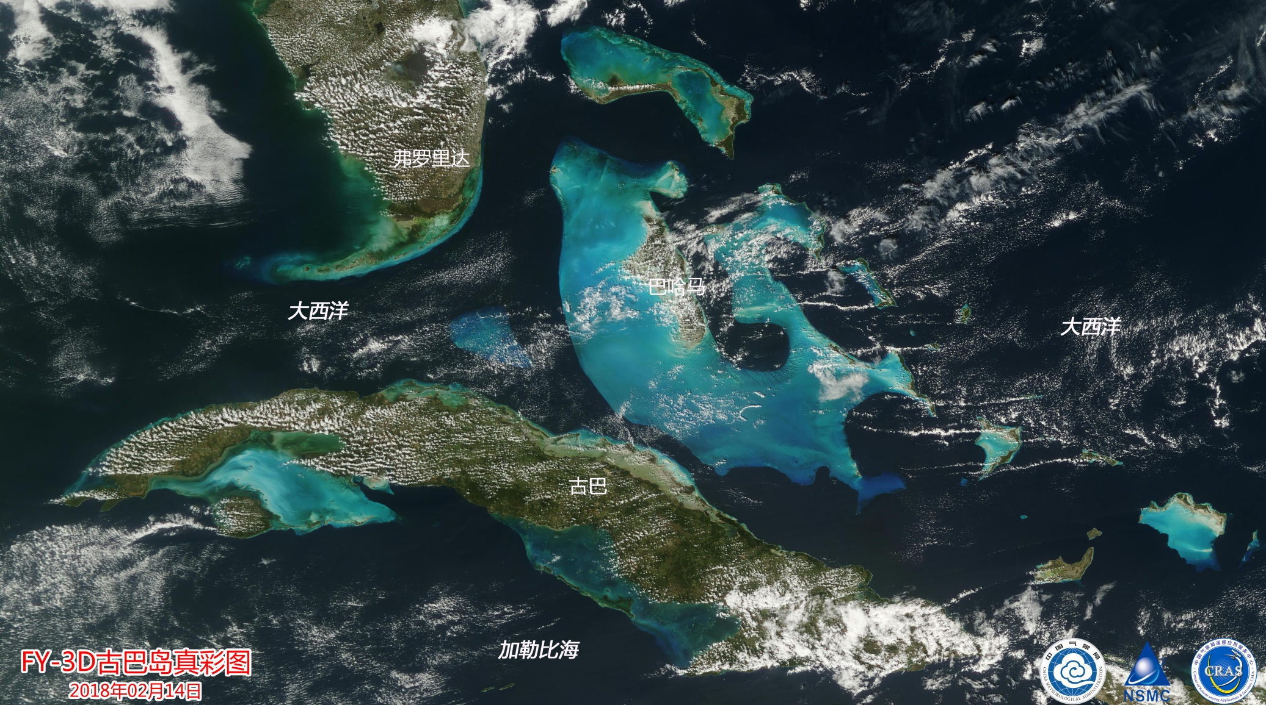
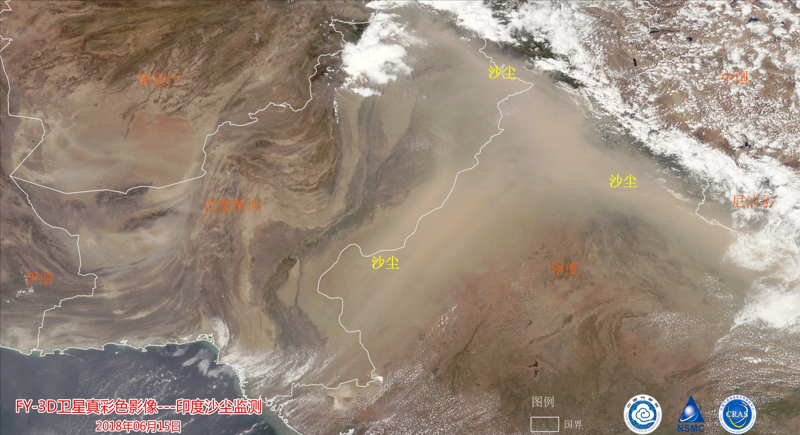
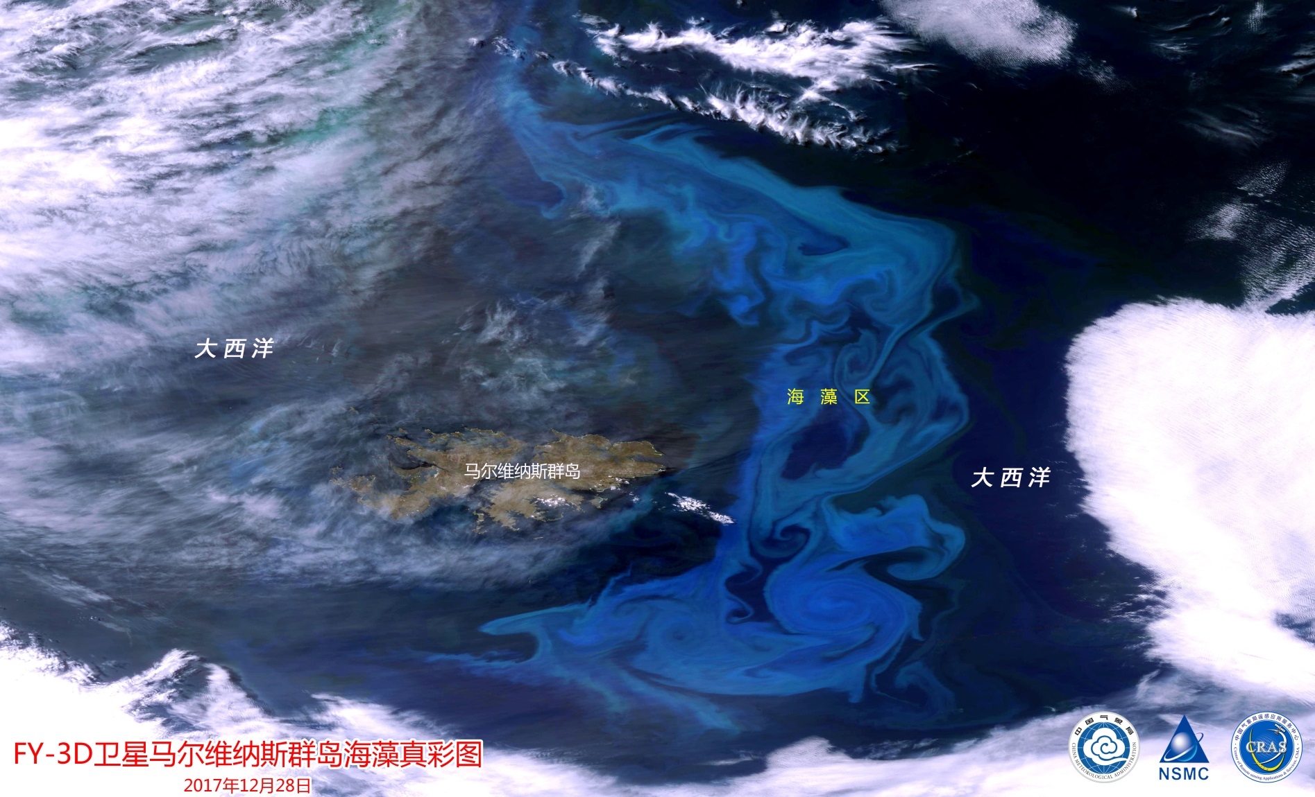
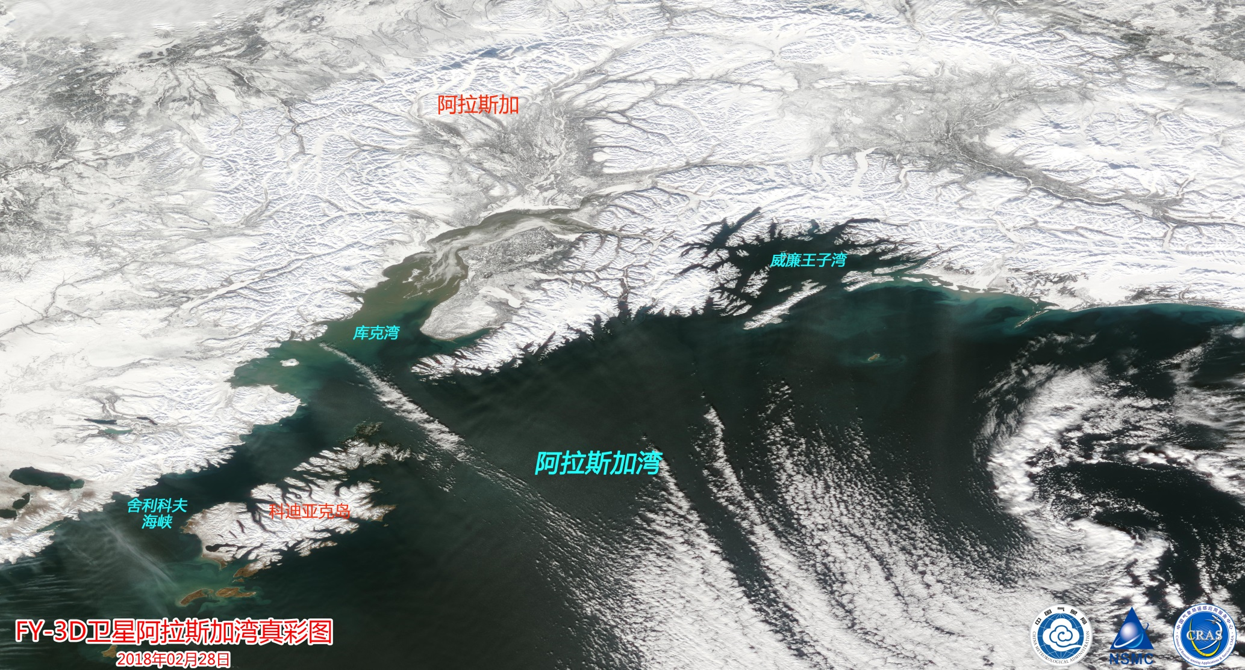
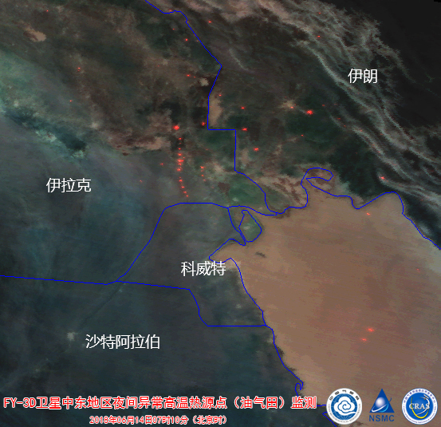
Typical Applications by using DB Data
Global monitoring

Slide 26
Thank you for your attention!
Lei Yang
National Satellite Meteorological Center, CMA
yangl@cma.gov.cn

